Slide 1
Real Time Big Data With Storm, Cassandra, and In-Memory Computing
Nati Shalom @natishalom
DeWayne Filppi @dfilppi

Slide 2


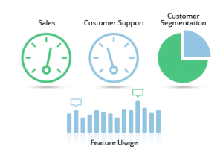








Introduction to Real Time Analytics
Social
User Tracking & Engagement
Homeland Security
eCommerce
Financial Services
Real Time Search
Notes:
ActiveInsight

Slide 3


The Two Vs of Big Data
Velocity
Volume

Slide 4

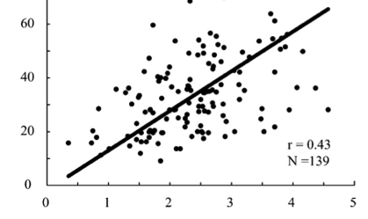

The Flavors of Big Data Analytics
Counting
Correlating
Research

Slide 5




It’s All about Timing
Event driven / stream processing
High resolution – every tweet gets counted
This is what we’re here to discuss ☺
Ad-hoc querying
Medium resolution (aggregations)
Long running batch jobs (ETL, map/reduce)
Low resolution (trends & patterns)

Slide 6
Facebook & Twitter Real Time Analytics
Notes:
ActiveInsight

Slide 7
Facebook Real-time Analytics System (Logging Centric Approach)

Slide 8
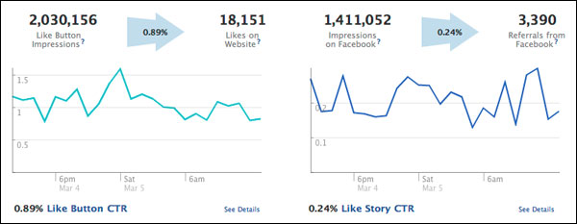
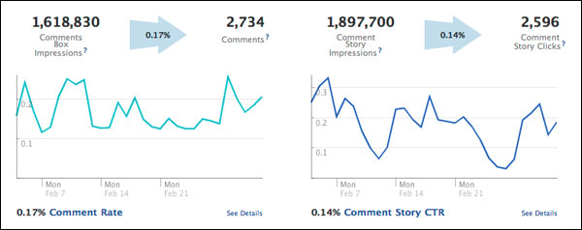
The actual analytics..
Like button analytics
Comments box analytics
Notes:
http://developers.facebook.com/blog/post/476/

Slide 9

Facebook architecture..
Real Time
Long Term
Scribe
10,000 write/sec per server
FACEBOOK
HDFS
Hbase
Log
FACEBOOK
PTail
Puma
Log
FACEBOOK
Batch
1.5 Sec
Log
Notes:
http://highscalability.com/blog/2011/3/22/facebooks-new-realtime-analytics-system-hbase-to-process-20.html
The Winner: HBase + Scribe + Ptail + Puma
At a high level:
HBase stores data across distributed machines.
Use a tailing architecture, new events are stored in log files, and the logs are tailed.
A system rolls the events up and writes them into storage.
A UI pulls the data out and displays it to users.
Data Flow
User clicks Like on a web page.
Fires AJAX request to Facebook.
Request is written to a log file using Scribe.
Scribe handles issues like file roll over.
Scribe is built on the same HTFS file store Hadoop is built on.
Write extremely lean log lines. The more compact the log lines the more can be stored in memory.
Ptail
Data is read from the log files using Ptail. Ptail is an internal tool built to aggregate data from multiple Scribe stores. It tails the log files and pulls data out.
Ptail data is separated out into three streams so they can eventually be sent to their own clusters in different datacenters.
Plugin impression
News feed impressions
Actions (plugin + news feed)
Puma
Batch data to lessen the impact of hot keys. Even though HBase can handle a lot of writes per second they still want to batch data. A hot article will generate a lot of impressions and news feed impressions which will cause huge data skews which will cause IO issues. The more batching the better.
Batch for 1.5 seconds on average. Would like to batch longer but they have so many URLs that they run out of memory when creating a hashtable.
Wait for last flush to complete for starting new batch to avoid lock contention issues.
UI Renders Data
Frontends are all written in PHP.
The backend is written in Java and Thrift is used as the messaging format so PHP programs can query Java services.
Caching solutions are used to make the web pages display more quickly.
Performance varies by the statistic. A counter can come back quickly. Find the top URL in a domain can take longer. Range from .5 to a few seconds.
The more and longer data is cached the less realtime it is.
Set different caching TTLs in memcache.
MapReduce
The data is then sent to MapReduce servers so it can be queried via Hive.
This also serves as a backup plan as the data can be recovered from Hive.
Raw logs are removed after a period of time.
HBase is a distribute column store.
Database interface to Hadoop. Facebook has people working internally on HBase.
Unlike a relational database you don't create mappings between tables.
You don't create indexes. The only index you have a primary row key.
From the row key you can have millions of sparse columns of storage. It's very flexible. You don't have to specify the schema. You define column families to which you can add keys at anytime.
Key feature to scalability and reliability is the WAL, write ahead log, which is a log of the operations that are supposed to occur.
Based on the key, data is sharded to a region server.
Written to WAL first.
Data is put into memory. At some point in time or if enough data has been accumulated the data is flushed to disk.
If the machine goes down you can recreate the data from the WAL. So there's no permanent data loss.
Use a combination of the log and in-memory storage they can handle an extremely high rate of IO reliably.
HBase handles failure detection and automatically routes across failures.
Currently HBase resharding is done manually.
Automatic hot spot detection and resharding is on the roadmap for HBase, but it's not there yet.
Every Tuesday someone looks at the keys and decides what changes to make in the sharding plan.
Schema
Store on a per URL basis a bunch of counters.
A row key, which is the only lookup key, is the MD5 hash of the reverse domain
Selecting the proper key structure helps with scanning and sharding.
A problem they have is sharding data properly onto different machines. Using a MD5 hash makes it easier to say this range goes here and that range goes there.
For URLs they do something similar, plus they add an ID on top of that. Every URL in Facebook is represented by a unique ID, which is used to help with sharding.
A reverse domain, com.facebook/ for example, is used so that the data is clustered together. HBase is really good at scanning clustered data, so if they store the data so it's clustered together they can efficiently calculate stats across domains.
Think of every row a URL and every cell as a counter, you are able to set different TTLs (time to live) for each cell. So if keeping an hourly count there's no reason to keep that around for every URL forever, so they set a TTL of two weeks. Typically set TTLs on a per column family basis.
Per server they can handle 10,000 writes per second.
Checkpointing is used to prevent data loss when reading data from log files.
Tailers save log stream check points in HBase.
Replayed on startup so won't lose data.
Useful for detecting click fraud, but it doesn't have fraud detection built in.
Tailer Hot Spots
In a distributed system there's a chance one part of the system can be hotter than another.
One example are region servers that can be hot because more keys are being directed that way.
One tailer can be lag behind another too.
If one tailer is an hour behind and the others are up to date, what numbers do you display in the UI?
For example, impressions have a way higher volume than actions, so CTR rates were way higher in the last hour.
Solution is to figure out the least up to date tailer and use that when querying metrics.

Slide 10
Twitter Real-time Analytics System (Event Driven Approach)

Slide 11
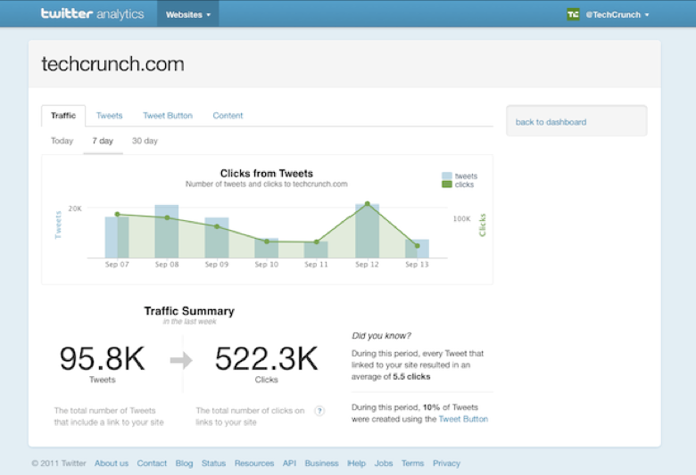
URL Mentions – Here’s One Use Case

Slide 12
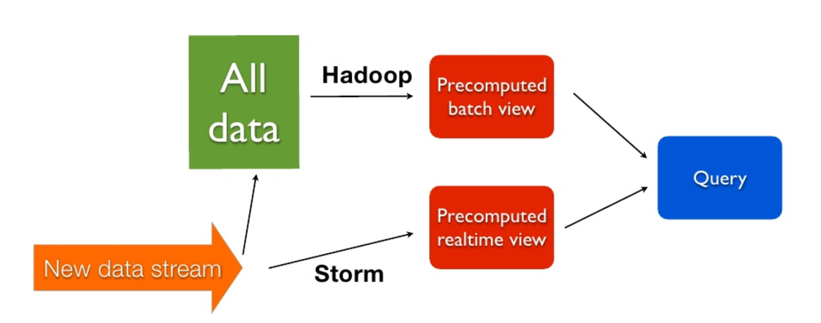
Twitter Real Time Analytics based on Storm

Slide 13
Comparing the two approaches..
Facebook
Twitter
Rely on Hadoop for Real Time and Batch
RT = 10’s Sec
Suits for Simple processing
Low parallelization
Use Hadoop for Batch and Storm for real time
RT = Msec, Sec
Suits for Complex processing
Extremely parallel
This is what we’re here to discuss ☺

Slide 14

Introduction to Storm

Slide 15
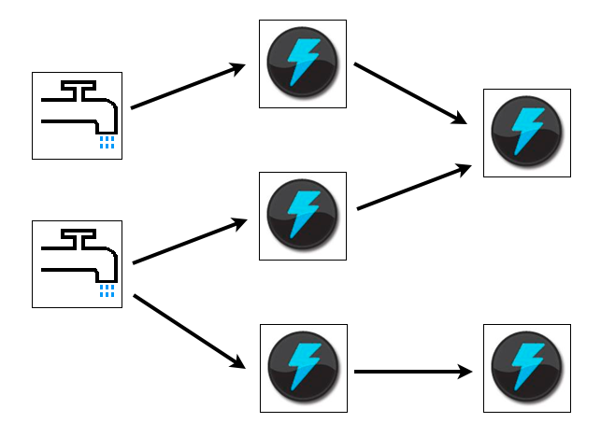
Storm Background
Popular open source, real time, in-memory, streaming computation platform.
Includes distributed runtime and intuitive API for defining distributed processing flows.
Scalable and fault tolerant.
Developed at BackType,
and open sourced by Twitter

Slide 16
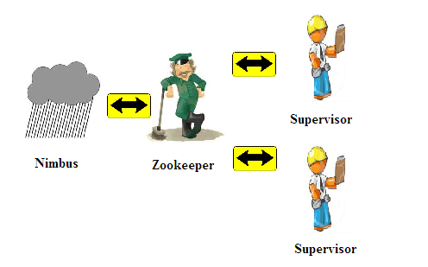
Storm Cluster

Slide 17
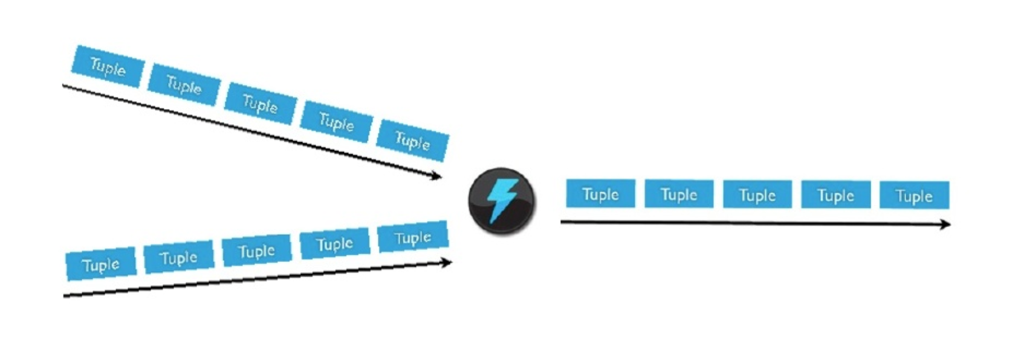
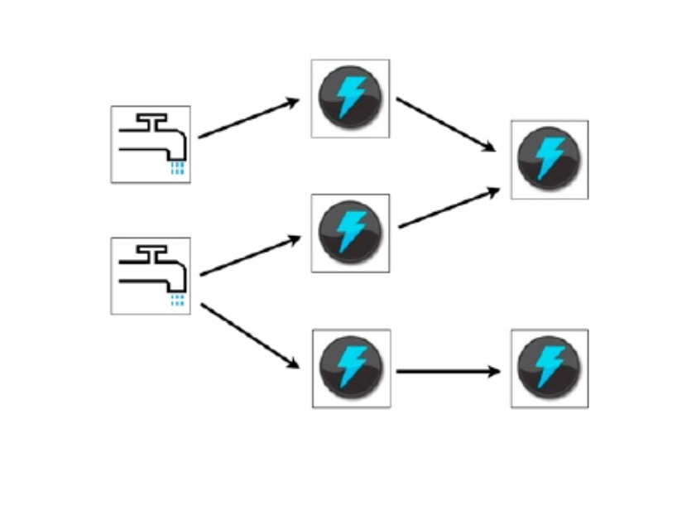
Storm Concepts
Spouts
Streams
Unbounded sequence of tuples
Spouts
Source of streams (Queues)
Bolts
Functions, Filters, Joins, Aggregations
Topologies
Bolt
Topologies

Slide 18



Challenge – Word Count
Tweets
?
Count
Word:Count
Hottest topics
URL mentions
etc.

Slide 19
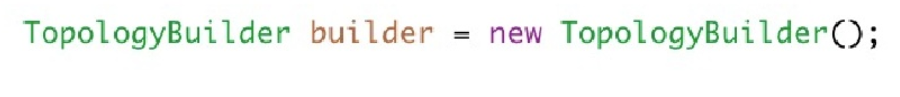
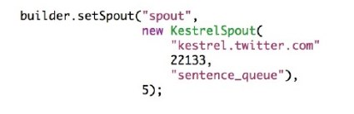
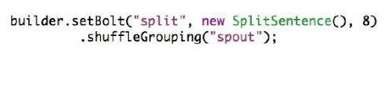
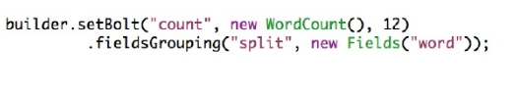
Streaming word count with Storm

Slide 20
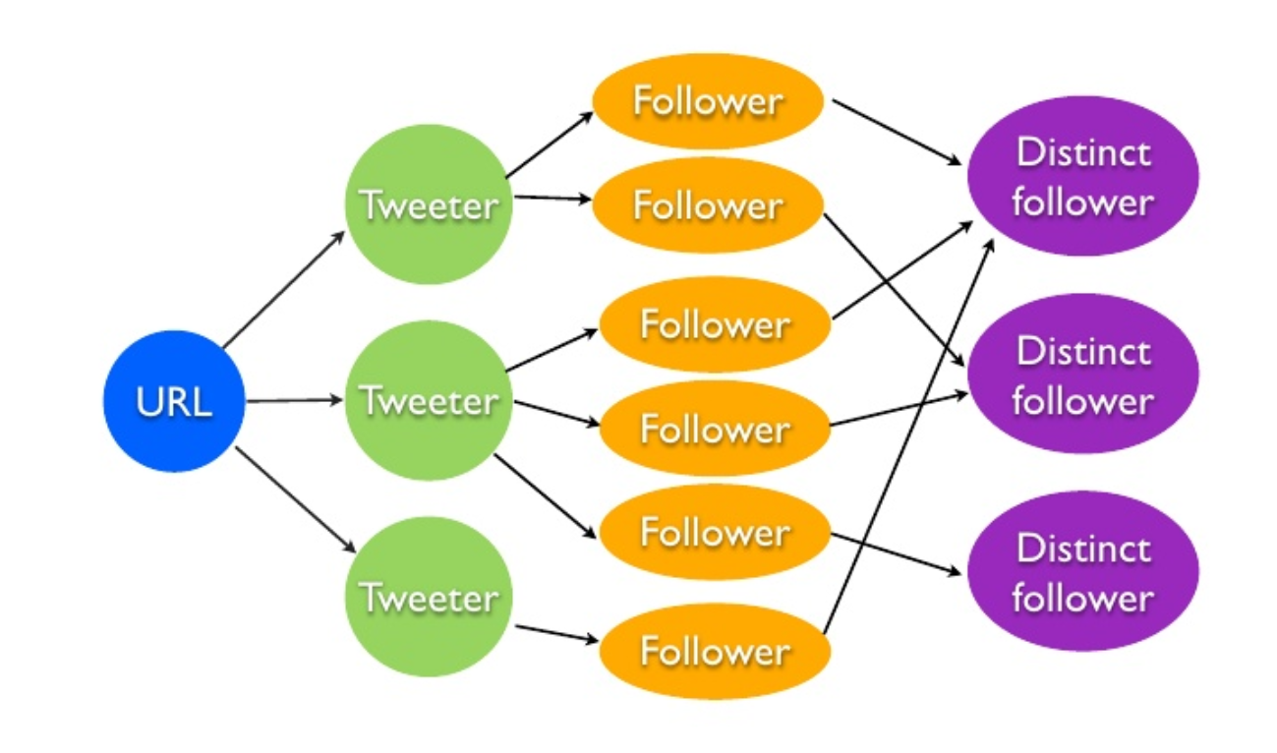
Computing Reach with Event Streams

Slide 21

But where is my
Big Data?

Slide 22
The Big Picture …
End to End Latency
Twitter feed
Twitter Feed
Twiter Feed
Reference Data
Counters
Research Data
Analytics Data
Data feeds (Kafka, Twitter,..)
Storm
Cassandra, MongoDB, Hbase,..
Bolt
Bolt
Spout
Web Activity
Web Activity
Web Activity

Slide 23
Your as as strong as your weakest link
Storm performance and reliability
Assumes success is normal
Uses batching and pipelining for performance
Storm plug-ins has significant effect on performance and reliability
Spout must be able to replay tuples on demand in case of error.
Storm uses topology semantics for ensuring consistency through event ordering
Can be tedious for handling counters
Doesn’t ensure the state of the counters
Notes:
Storm (quite rationally) assumes success is normal
Storm uses batching and pipelining for performance
Therefore the spout must be able to replay tuples on demand in case of error.
Any kind of quasi-queue like data source can be fashioned into a spout.
No persistence is ever required, and speed attained by minimizing network hops during topology processing.

Slide 24

Typical user experience…
Now, Kafka is *fast*. When running the Kafka Spout by itself, I easily reproduced Kafka's claim that you can consume "hundreds of thousands of messages per second".
When I first fired up the topology, things went well for the first minute, but then quickly crashed as the Kafka spout emitted too fast for the Cassandra Bolt to keep up. Even though Cassandra is fast as well, it is still orders of magnitude slower than Kafka
Source: A Big Data Trifecta: Storm, Kafka and Cassandra. Brian Oniells Blog

Slide 25
An Alternative Approach
What if we could put everything In Memory?

Slide 26
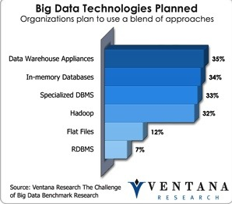

Did you know?
Facebook keeps 80% of its data in Memory (Stanford research)
RAM is 100-1000x faster than Disk (Random seek)
Disk: 5 -10ms
RAM: ~0.001msec

Slide 27
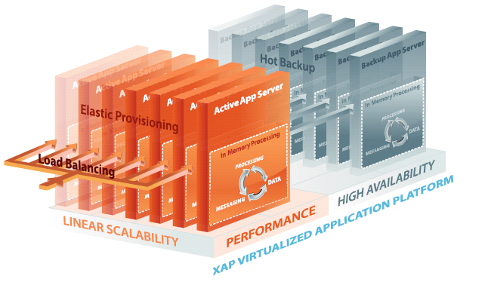
In Memory Data Grid Review
RAM is the new disk
Data partitioned across a cluster
Large “virtual” memory space
Transactional
Highly available
Code with Data

Slide 28
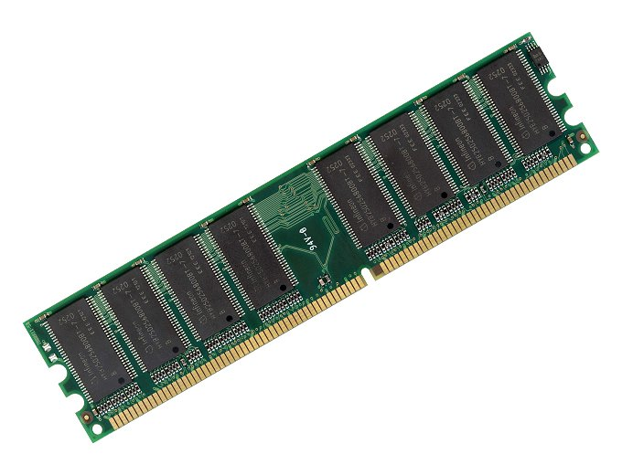
Integrating with Storm
In Memory Data Stream
(Via Storm Spout Plugin)
In Memory Data Grid
(via Storm Trident State plug-in)
Reference Data
Counters
Research Data
Analytics Data
Bolt
Bolt
Spout
Web Activity
Web Activity
Web Activity

Slide 29
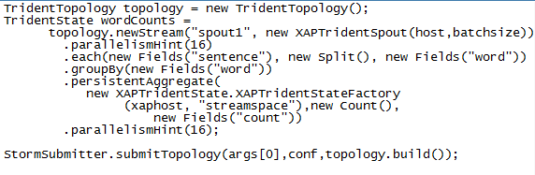
In Memory Streaming Word Count with Storm
Storm has a simple builder interface to creating stream processing topologies
Storm delegates persistence to external providers

Slide 30
Integrating with Hadoop, NoSQL DB..
In Memory Data Stream Storm Plugin
In Memory Data Grid
Web Activity
Web Activity
Web Activity
Reference Data
Counters
Research Data
Analytics Data
Bolt
Bolt
Spout
Write Behind
LRU based Policy
Hadoop, NoSQL, RDBMS,…

Slide 31
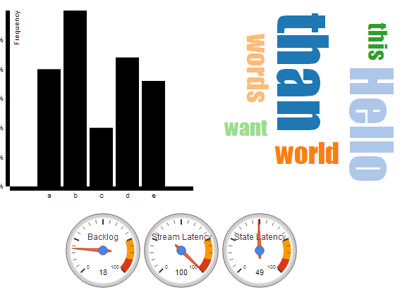
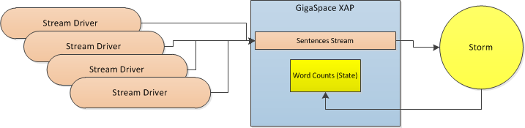
Live Demo – Word Count At In Memory Speed

Slide 32
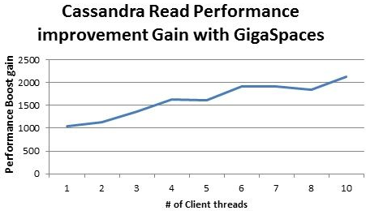


Recent Benchmarks..
Gresham Computing plc, achieved over 50,000 equity trade transactions per second of load and match into a database.
Notes:
http://www.gigaspaces.com/greshams-ctc-reconciles-transactions-orders-magnitude-faster-competitive-offerings-intel-benchmarkin
http://natishalom.typepad.com/nati_shaloms_blog/2013/01/in-memory-computing-data-grid-for-big-data.html

Slide 34
References
Try the Cloudify recipe
Download Cloudify : http://www.cloudifysource.org/
Download the Recipe (apps/xapstream, services/xapstream):
https://github.com/CloudifySource/cloudify-recipes
XAP – Cassandra Interface Details;
http://wiki.gigaspaces.com/wiki/display/XAP95/Cassandra+Space+Persistency
Check out the source for the XAP Spout and a sample state implementation backed by XAP, and a Storm friendly streaming implemention on github:
https://github.com/Gigaspaces/storm-integration
For more background on the effort, check out my recent blog posts at http://blog.gigaspaces.com/
http://blog.gigaspaces.com/gigaspaces-and-storm-part-1-storm-clouds/
http://blog.gigaspaces.com/gigaspaces-and-storm-part-2-xap-integration/
Part 3 coming soon.

